Slide 1
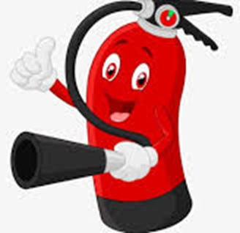
ESCRA Fire Extinguisher Training 11/15/2023

Slide 2
ESCRA Fire Extinguisher Training
What is Fire? A Fire is a self-sustaining, chemical chain reaction with varying degrees of light and heat.
Understanding the 5 different classes of fires can help you determine the biggest fire risks at your facility, depending on the fuels and fire hazards present as well as how best to prepare in case of a fire emergency.
Each class of fire is designated by a letter and/or a symbol.

Slide 3
ESCRA Fire Extinguisher Training
Class A Fire: solid materials such as wood or paper, fabric, and some plastics.
Class A fires are the most common of the 5 different classes of fires. They occur when common combustible materials like wood, paper, fabric, trash, and light plastics catch fire. These accidental fires are ubiquitous across a variety of industries, so it’s recommended to have adequate protection against “ordinary” fires in addition to other condition-specific fires.
Despite being “ordinary”, don’t rule this class of fire as low-risk. If there’s an abundance of fuel present, these fires can intensify quickly. It’s best to put out a Class A fire quickly before it spreads using water or monoammonium phosphate.

Slide 4
ESCRA Fire Extinguisher Training
Class B Fire: liquids or gas such as alcohol, ether, gasoline, or grease
Class B fires involve flammable liquids and gases, especially fuels like petroleum or petroleum-based products such as gasoline, paint, and kerosene. Other gases that are highly flammable are propane and butane, which are common causes of Class B fires. The best way to deal with these types of fires is by smothering them or removing oxygen using foam or CO2 fire suppression equipment.
Be aware that Class B fires do not include grease fires or cooking fires, which belong to their own class, Class K.

Slide 5
ESCRA Fire Extinguisher Training
Class C Fire: electrical failure from appliances, electronic equipment, and wiring
Electrical fires fall under Class C and are common in facilities that make heavy use of electrical equipment, but they can occur in a wide range of industries. For example, data centers might be an obvious risk area for Class C fires. They must have safeguards in place to deal with electrical fires.
Electrical fires require non-conductive materials to extinguish the flame, so water alone is not a good solution. Facilities with sensitive equipment may prefer clean agent suppression because it won’t leave residue or damage electrical equipment.

Slide 6
ESCRA Fire Extinguisher Training
Class D Fire: metallic substances such as sodium, titanium, zirconium, or magnesium
Class D fires are not as common as the other classes, but they do require special attention because they can be especially difficult to extinguish. Metallic fires involve flammable materials like titanium, aluminum, magnesium, and potassium — all commonly occurring in laboratories.
Class D fires cannot be addressed with water, as this can exacerbate the fire and be potentially dangerous. Dry powder agents are the best solution for smothering the flames and limiting damage to property or people.

Slide 7
ESCRA Fire Extinguisher Training
Class K Fire: grease or oil fires specifically from cooking.
Class K fires involve flammable liquids, similar to Class B fires, but are specifically related to food service and the restaurant industry. These common fires start from the combustion of liquid cooking materials including grease, oils, and vegetable and animal fats.
Because they can spread quickly and be difficult to manage, Class K fires are some of the most dangerous. Water can make the situation worse, but smothering the flames or using a wet agent fire extinguisher is effective.
Now that we understand how each fire starts, we can prepare for how to fight them — or better yet, prevent them from happening in the first place.

Slide 8
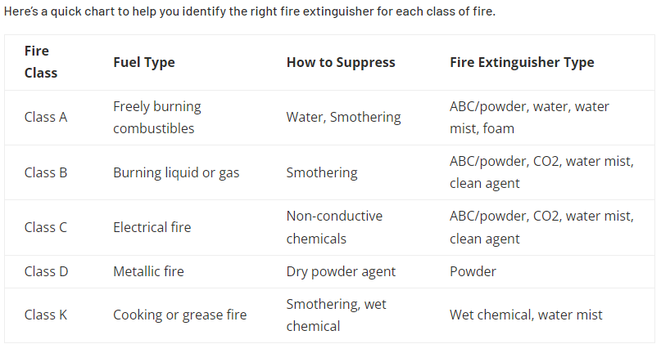
ESCRA Fire Extinguisher Training

Slide 9
ESCRA Fire Extinguisher Training
Fire Extinguisher Use
Use the acronym PASS to remember how to use a fire extinguisher.
P – Pull
A – Aim
S – Squeeze
S – Sweep

Slide 10
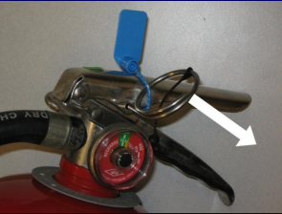
ESCRA Fire Extinguisher Training
PULL
Hold Fire Extinguisher Firmly and Pull The Pin Out.

Slide 11
ESCRA Fire Extinguisher Training
AIM
Aim the nozzle at the base of the fire.

Slide 12
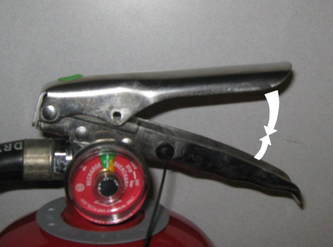
ESCRA Fire Extinguisher Training
SQUEEZE
Squeeze the handle of the fire extinguisher.

Slide 13
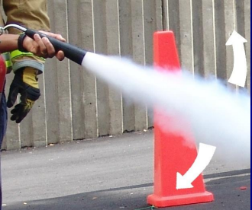
ESCRA Fire Extinguisher Training
SWEEP
Sweep back and forth at the base of the fire until the fire is out or the extinguisher has emptied.

