Slide 1
ESCRA Ferric Chloride Training
March 20, 2024

Slide 2
Ferric Chloride Properties
Ferric chloride is an orange to brown-black aqueous solution that has a faint hydrochloric acid odor.
Ferric Chloride when wet it is corrosive to aluminum and most metals.
Ferric Chloride itself does not burn, but may decompose upon heating (for example during a fire) to produce corrosive and/or toxic fumes.
Ferric chloride has the potential to react with metals to form flammable and potentially explosive hydrogen gas.

Slide 3
Why Do We Use Ferric Chloride?
Ferric chloride is the coagulant of choice for many industrial and sanitary wastewater treatment applications, due to its high efficiency, effectiveness in clarification, and utility as a sludge dewatering agent. Ferric Chloride is added to the mixed liquor in the Distribution Box to precipitate phosphorous for ultimate removal in the final clarifiers.
Phosphates act as a nutrient for algae. Removal of there by Ferric Chloride prevents algae growth in water. Ferric Chloride precipitates Phosphates out of the water which then filters out in the secondary clarifier.
Flocculation – The process that forces the particles to coagulate or “floc” together and settle in the secondary clarifier. This process produces a cleaner effluent.

Slide 4
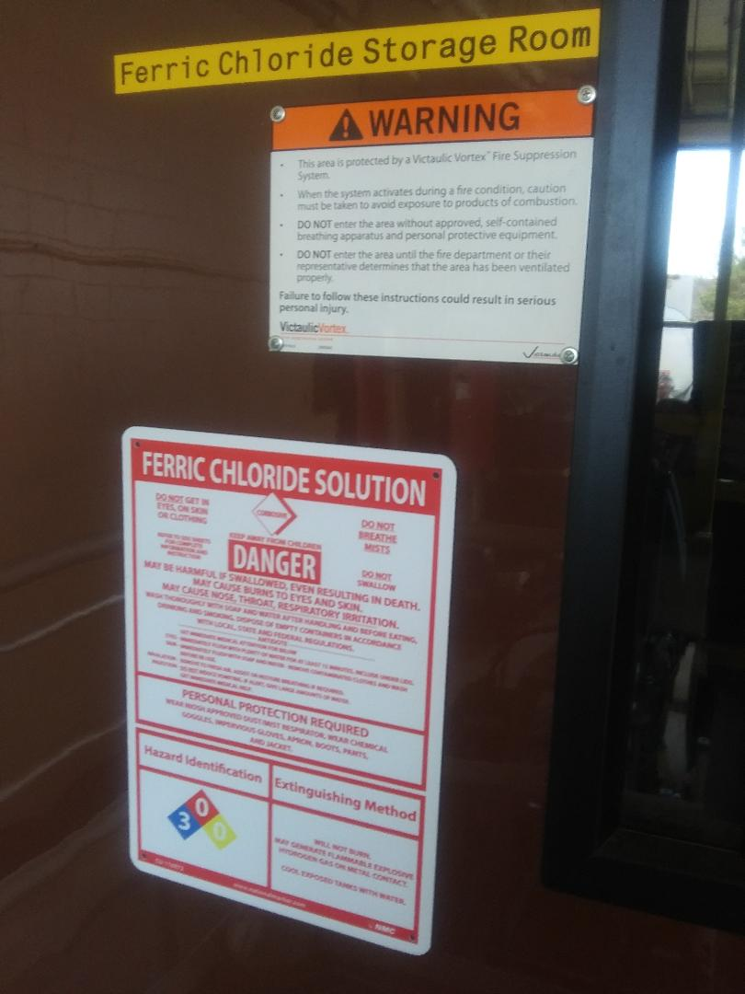
Ferric Chloride Storage Room Safety

Slide 5
Ferric Chloride FIRST AID / SAFETY
Eye Contact First Aid: Immediately flush eyes for 15 minutes with large amounts of water while holding eyelids apart. Washing within one minute is essential to achieve maximum effectiveness. Obtain medical attention IMMEDIATELY after flushing.
Skin Contact First Aid: Flush skin with water. Remove contaminated clothing; wash before reuse. If irritation is still present, seek medical attention IMMEDIATELY.
Inhalation First Aid: Move to fresh air. If breathing becomes difficult, obtain medical attention IMMEDIATELY.

Slide 6
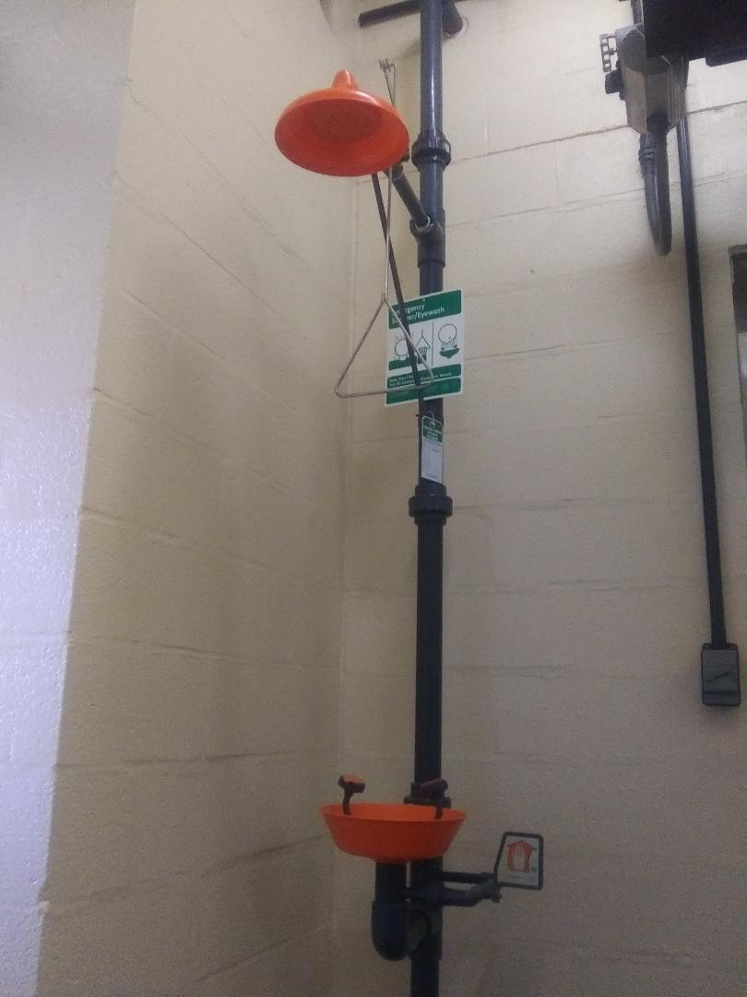
Ferric Chloride Safety Shower

Slide 7
Ferric Chloride Personal Protective Equipment
When working with Ferric Chloride the following PPE should be worn:
  Protective Gloves
  Eye Protection – Goggles or a Face Shield
  Contact lenses should not be worn when working with Ferric Chloride.

Slide 8
Ferric Chloride Spill or Leak
In the event that a Ferric Chloride Spill or Leak occurs notify a supervisor immediately.
At the control computer or the MCC the Ferric Chloride System should be turned off immediately.
A supervisor will determine what the proper cleanup and disposal method will be.

Slide 9
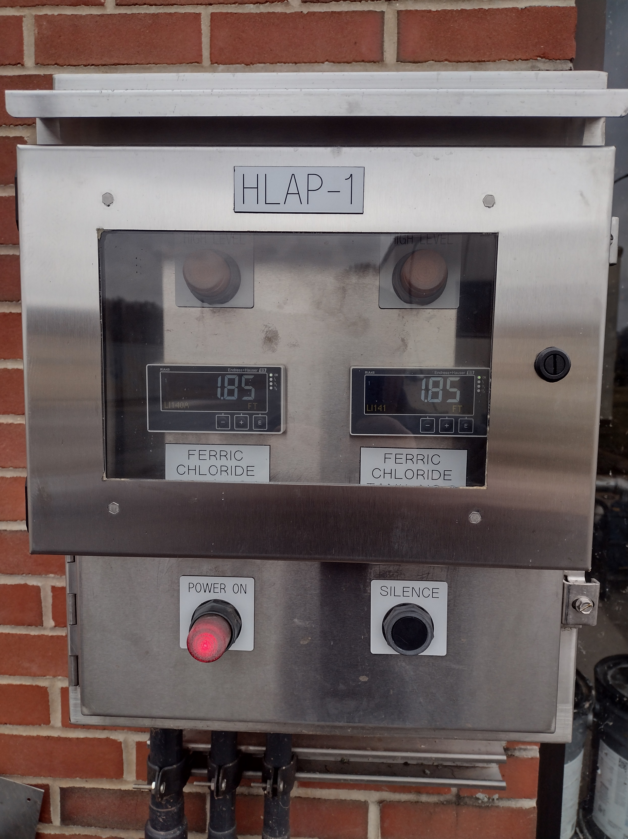
Ferric Chloride Outside Control Panel

Slide 10
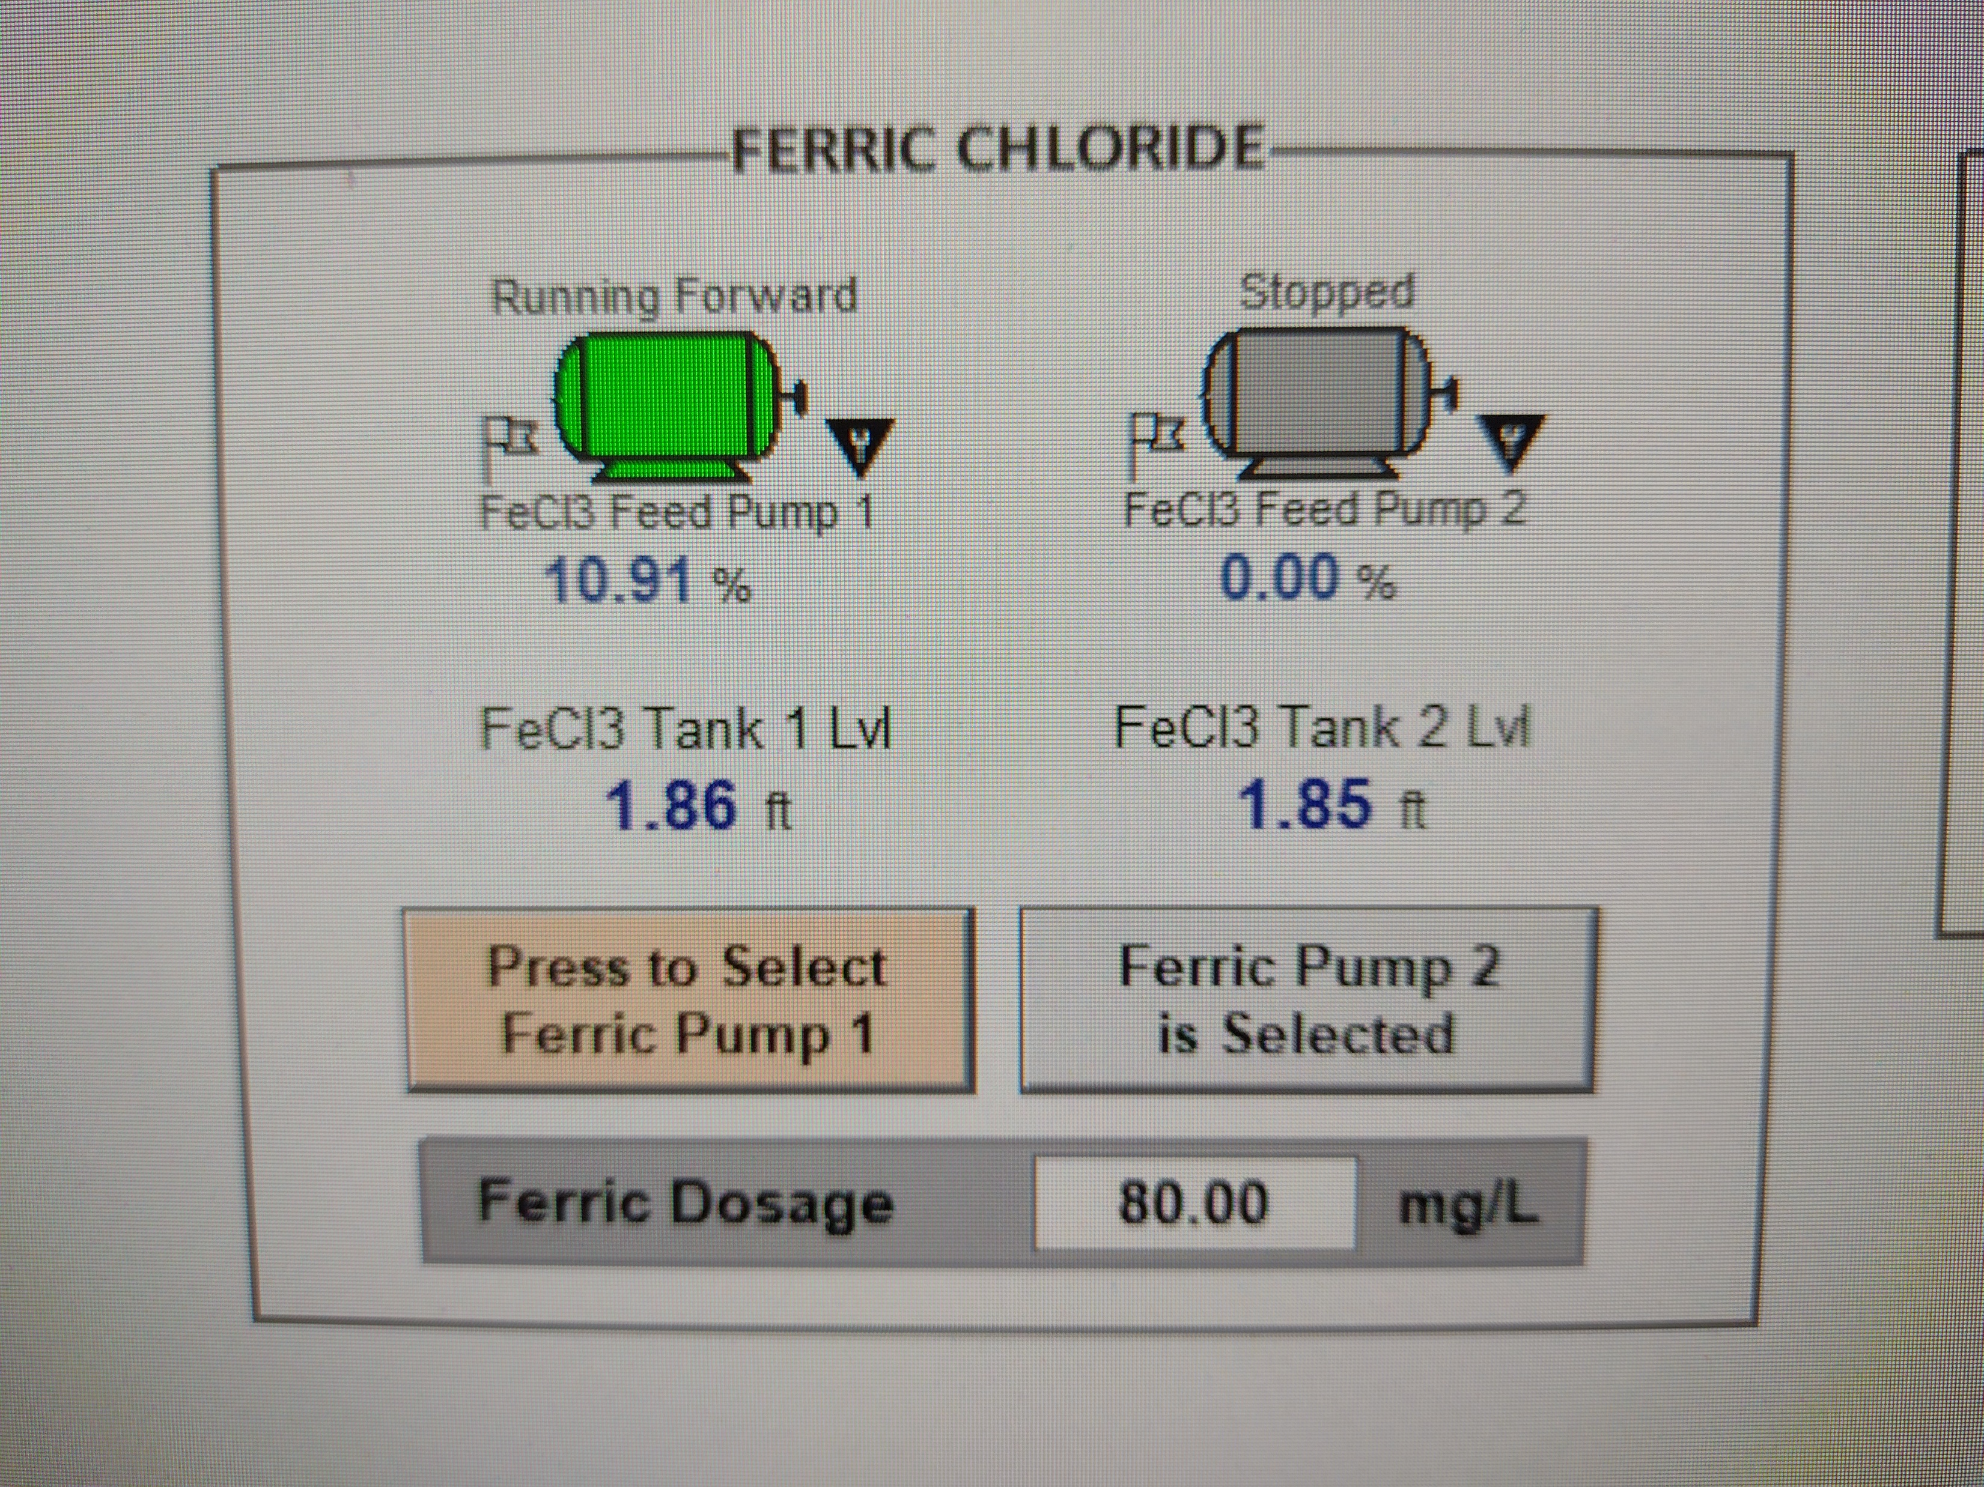
Ferric Chloride Control System
Located Under the Chemical Tab on the SCADA Computer

Slide 11
Ferric Chloride Delivery
ESCRA receives a Ferric Chloride delivery approximately every 10 weeks depending on consumption rates.
A Ferric Chloride Delivery is approximately 45,000 lbs.
ESCRA Storage capacity is approximately 5,000 Gallons.
On the control computer at 8.5 feet the tanks are considered full and at .8 of a foot the tanks are considered to be empty.
Anyone who is supervising a delivery should wear gloves and eye protection when the hose is being connected or disconnected.

