Slide 1
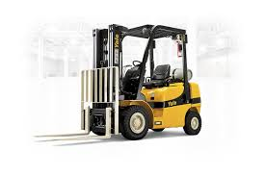
ESCRA Forklift Training

Slide 2
ESCRA Forklift Training
Why Forklift Training Is Necessary
100 fatalities each year
20,000 lost workday injuries annually
Common injuries
Hitting a pedestrian
Tipping over
Falling from raised forks
Falling from a ladder struck with a forklift
Falling material
Training reduces injuries

Slide 3
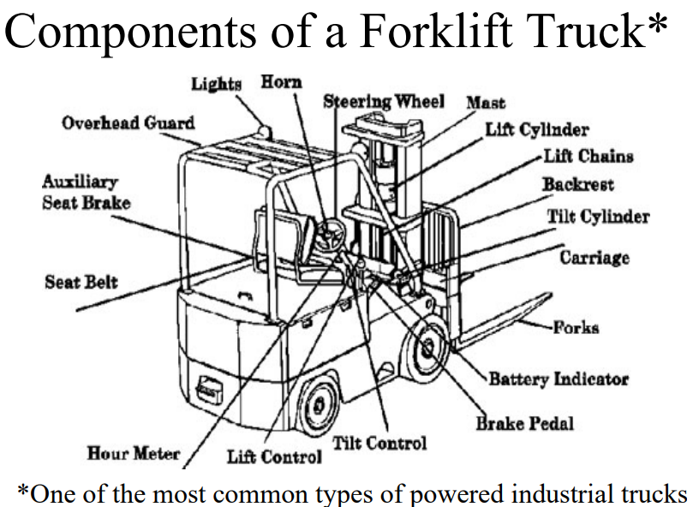
ESCRA Forklift Training

Slide 4
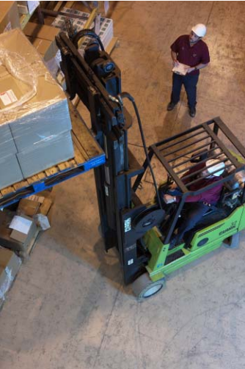
ESCRA Forklift Training
Basic Forklift rules
Don’t stand or pass under raised forks.
Only handle stable loads within truck’s rated capacity.
Use a safety platform to lift people.
Only use approved trucks in hazardous locations.
Lower forks, neutralize controls, shut off engine, and
set brakes when truck is unattended

Slide 5
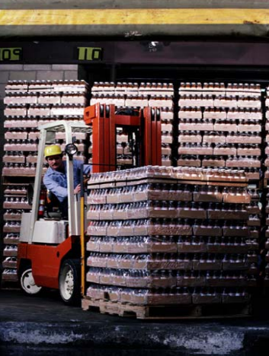
ESCRA Forklift Training
While in the Operator Seat
Make nonmoving checks—gauges, lights,
horn, backup alarm, warning light, tilt and
lift mechanism, and parking brake
Make moving checks—seat belt, running
brakes, and steering
Operator visibility
Loads can restrict vision.
Look in the direction of travel.
Check blind spots.

Slide 6
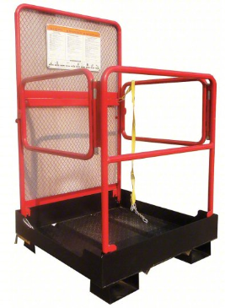
ESCRA Forklift Training
Attachments
Attachments act like extensions to the length
or width of the forklift and, therefore, require
additional operating clearance.
Adding an attachment is like permanently carrying
a load. If the attachment weighs 1,000 pounds (lb),
your forklift’s capacity is automatically reduced by
1,000 lb.
Attachments typically move the load farther away
from the forklift, which increases your load center.
If the attachment moves the load 8 in. away, it will
reduce the capacity by approximately 800 lb (100 lb per in.)
because loads that normally have a load center of 24 in.
now have a 32-in. load center.

Slide 7
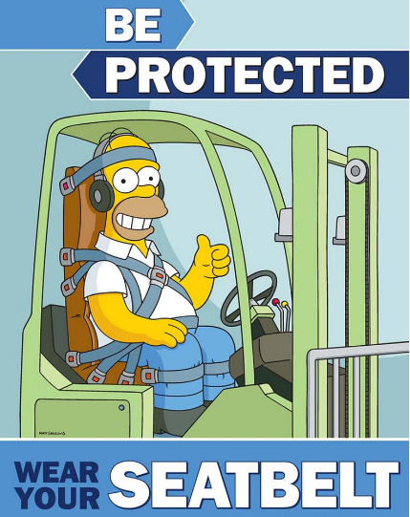
ESCRA Forklift Training
Unintentional, mistaken operation
can cause serious accidents
A 5,000-pound forklift at 10 mph with
a 4,000 pound load has a potential
destructive force of 135,000 pounds
of energy.

