Slide 1
ESCRA LOCKOUT/TAGOUT TRAINING
2/21/2024

Slide 2
ESCRA LOCKOUT/TAGOUT
What is LOCKOUT/TAGOUT?
The Lockout/Tagout standard requires the adoption and implementation of practices and procedures to shut down equipment, isolate it from its energy source(s), and prevent the release of potentially hazardous energy while maintenance and servicing activities are being performed.
What is hazardous energy?
Energy sources including electrical, mechanical, hydraulic, pneumatic, chemical, thermal, or other sources in machines and equipment can be hazardous to workers. During the servicing and maintenance of machines and equipment, the unexpected startup or release of stored energy can result in serious injury or death to workers.

Slide 3
ESCRA LOCKOUT/TAGOUT
One important maintenance safety practice is known as lockout/tagout, or what OSHA now calls the Control of Hazardous Energy. This practice helps ensure that moving parts don't move when you're working on them (unless you want them to), and that no electricity is flowing through equipment that can shock you while you're repairing it.

Slide 4
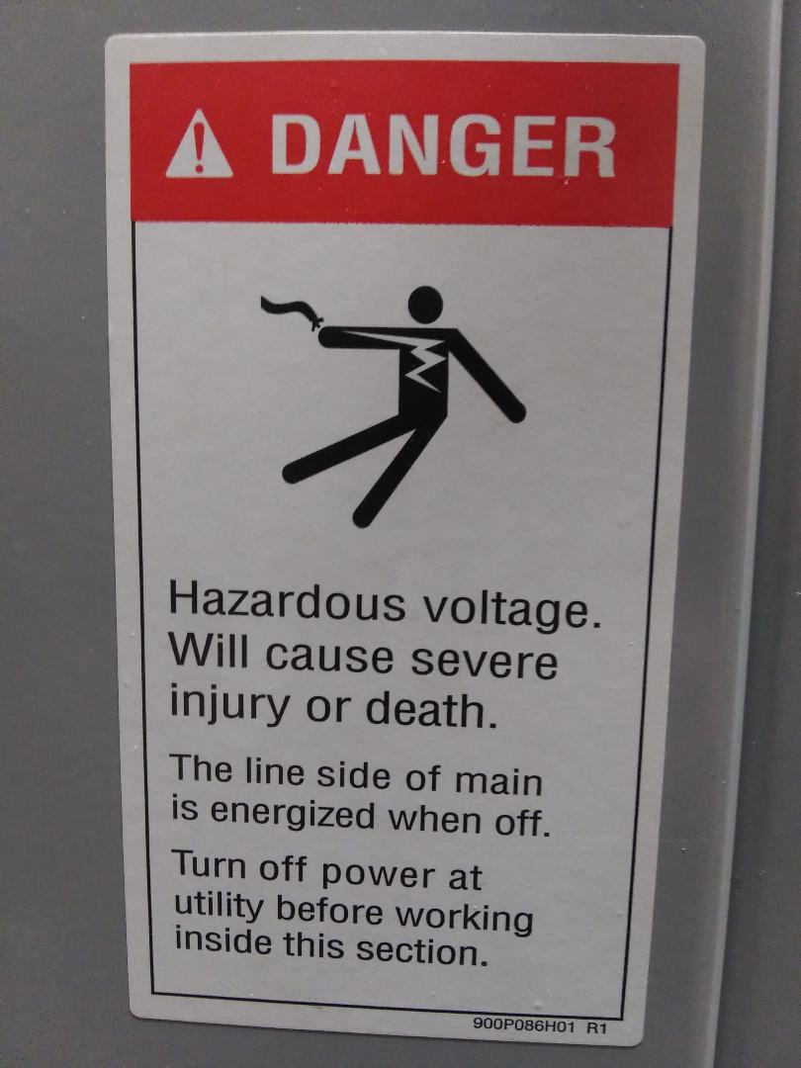
ESCRA LOCKOUT/TAGOUT

Slide 5
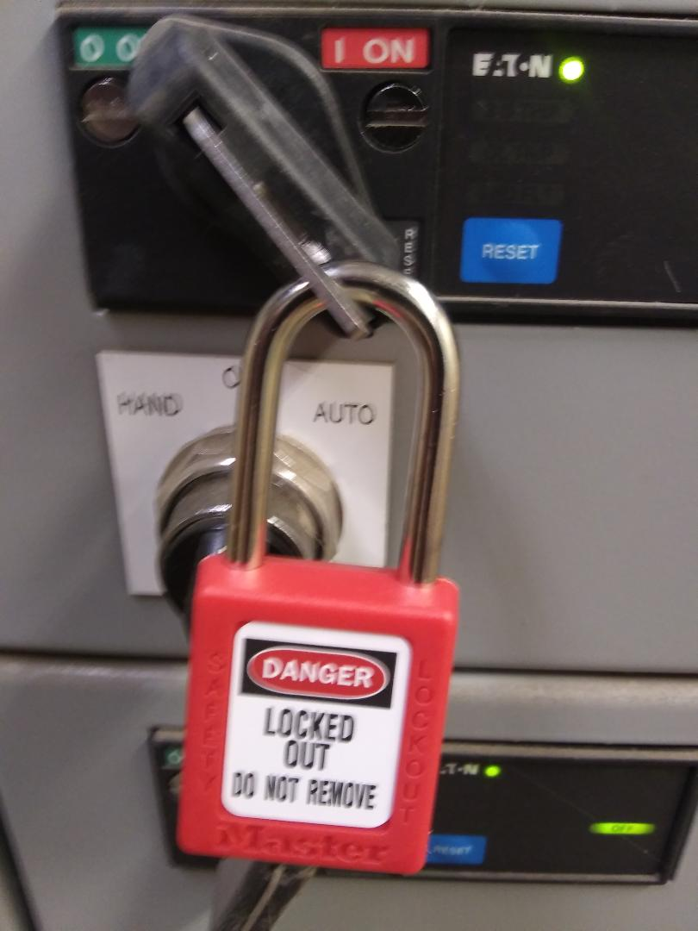
ESCRA LOCKOUT/TAGOUT
Prior to completing any work the energy source must be LOCKED OUT

Slide 6
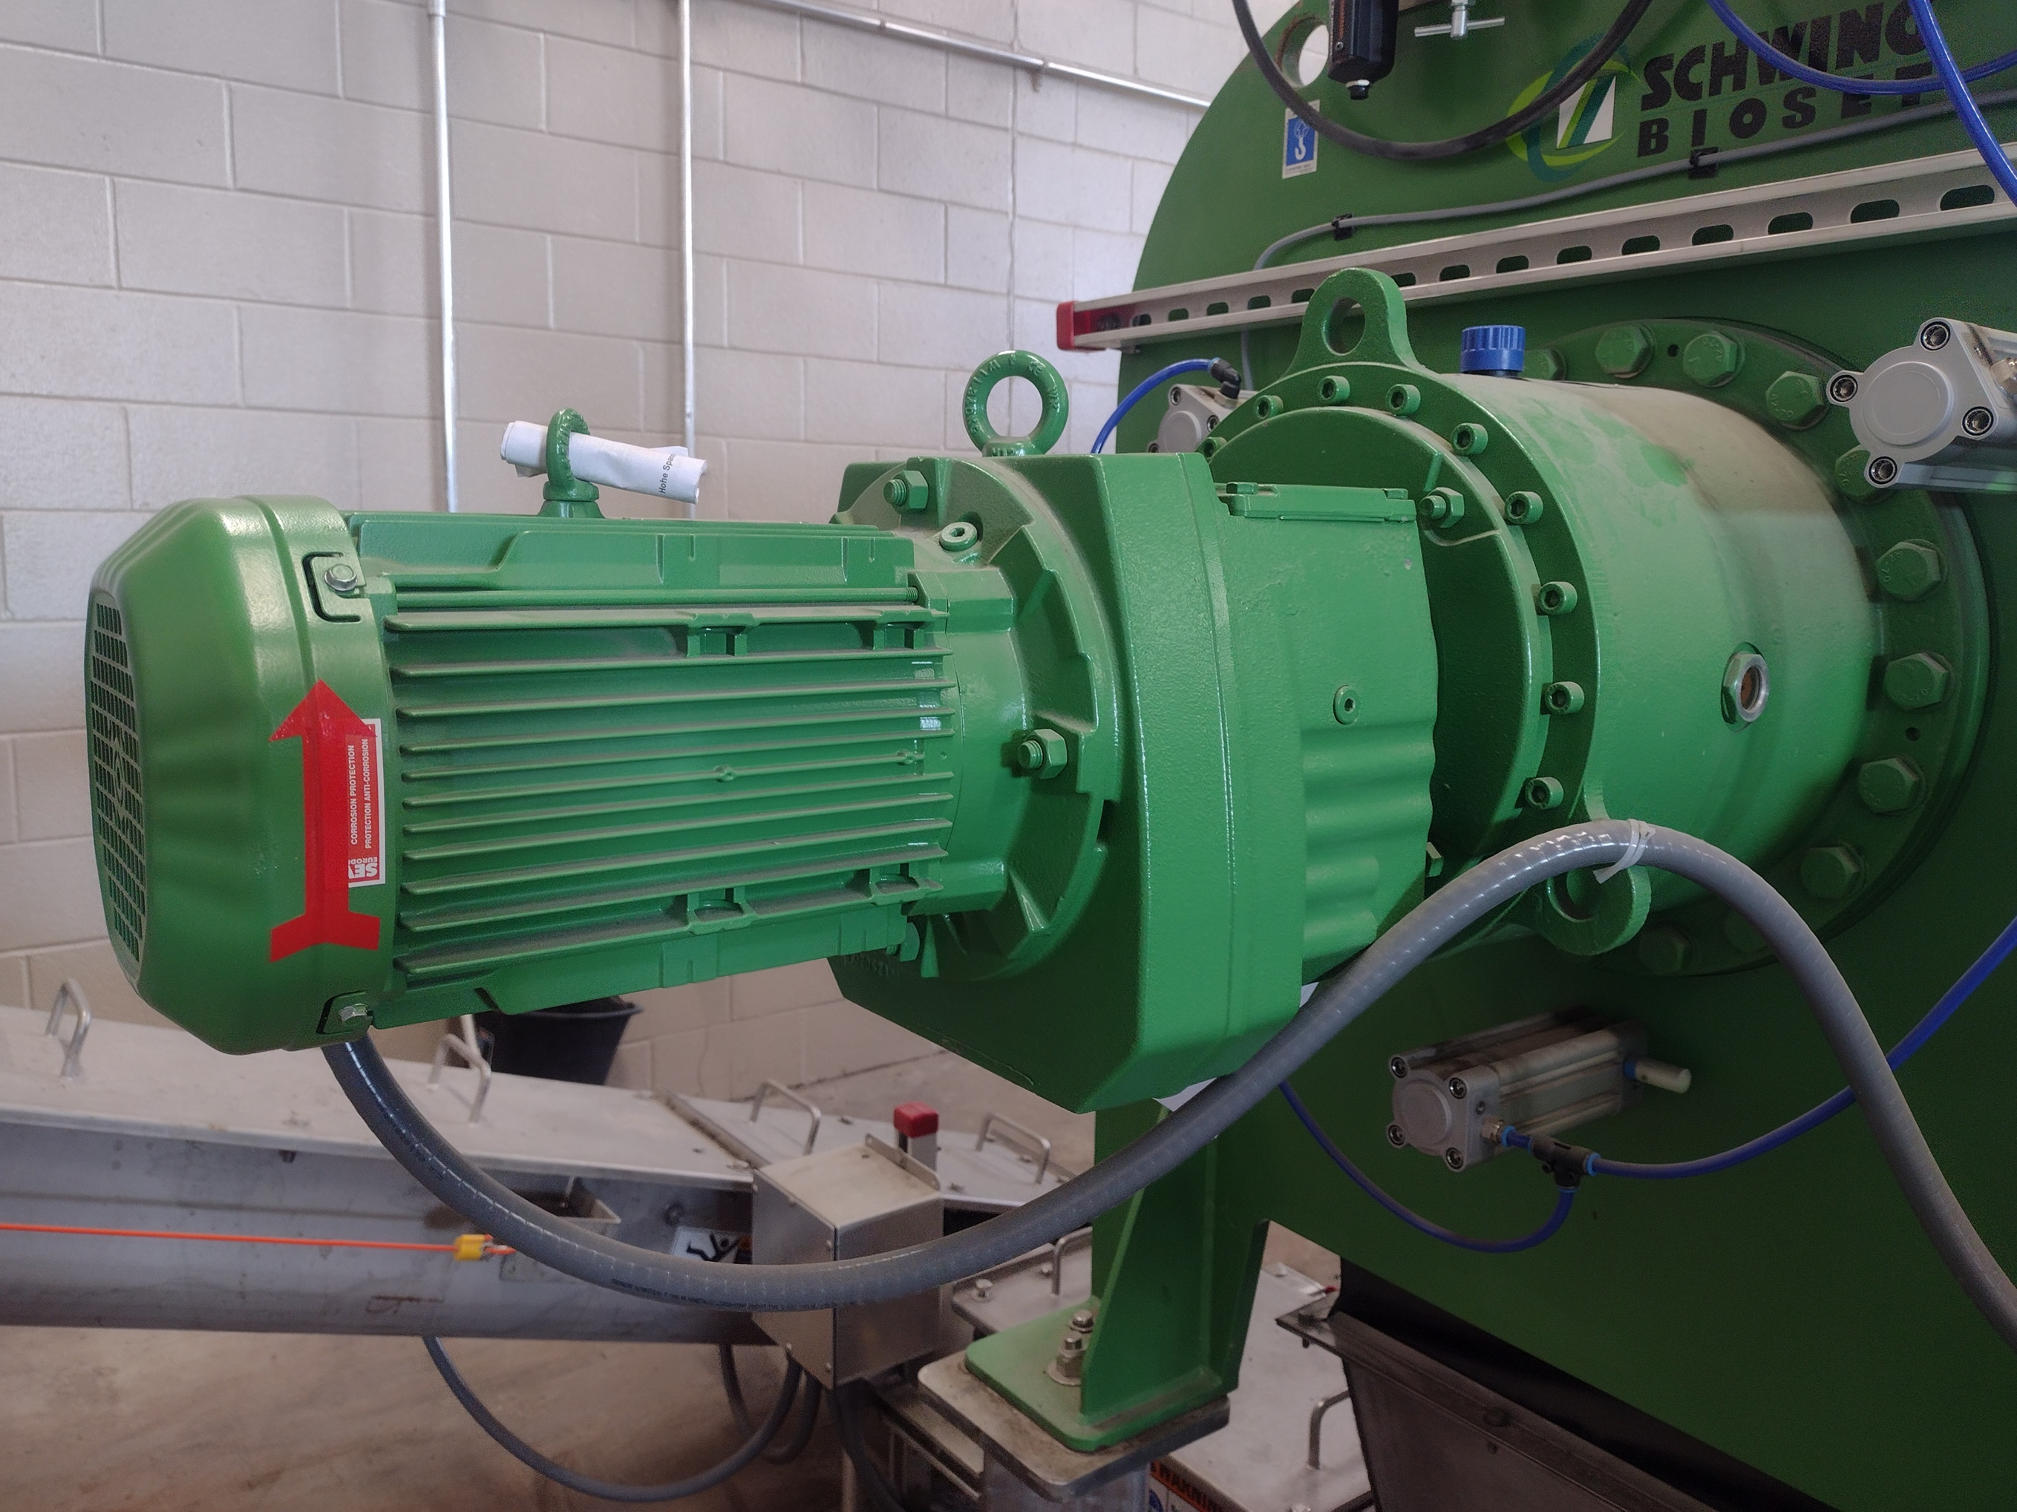
ESCRA LOCKOUT/TAGOUT

Slide 7
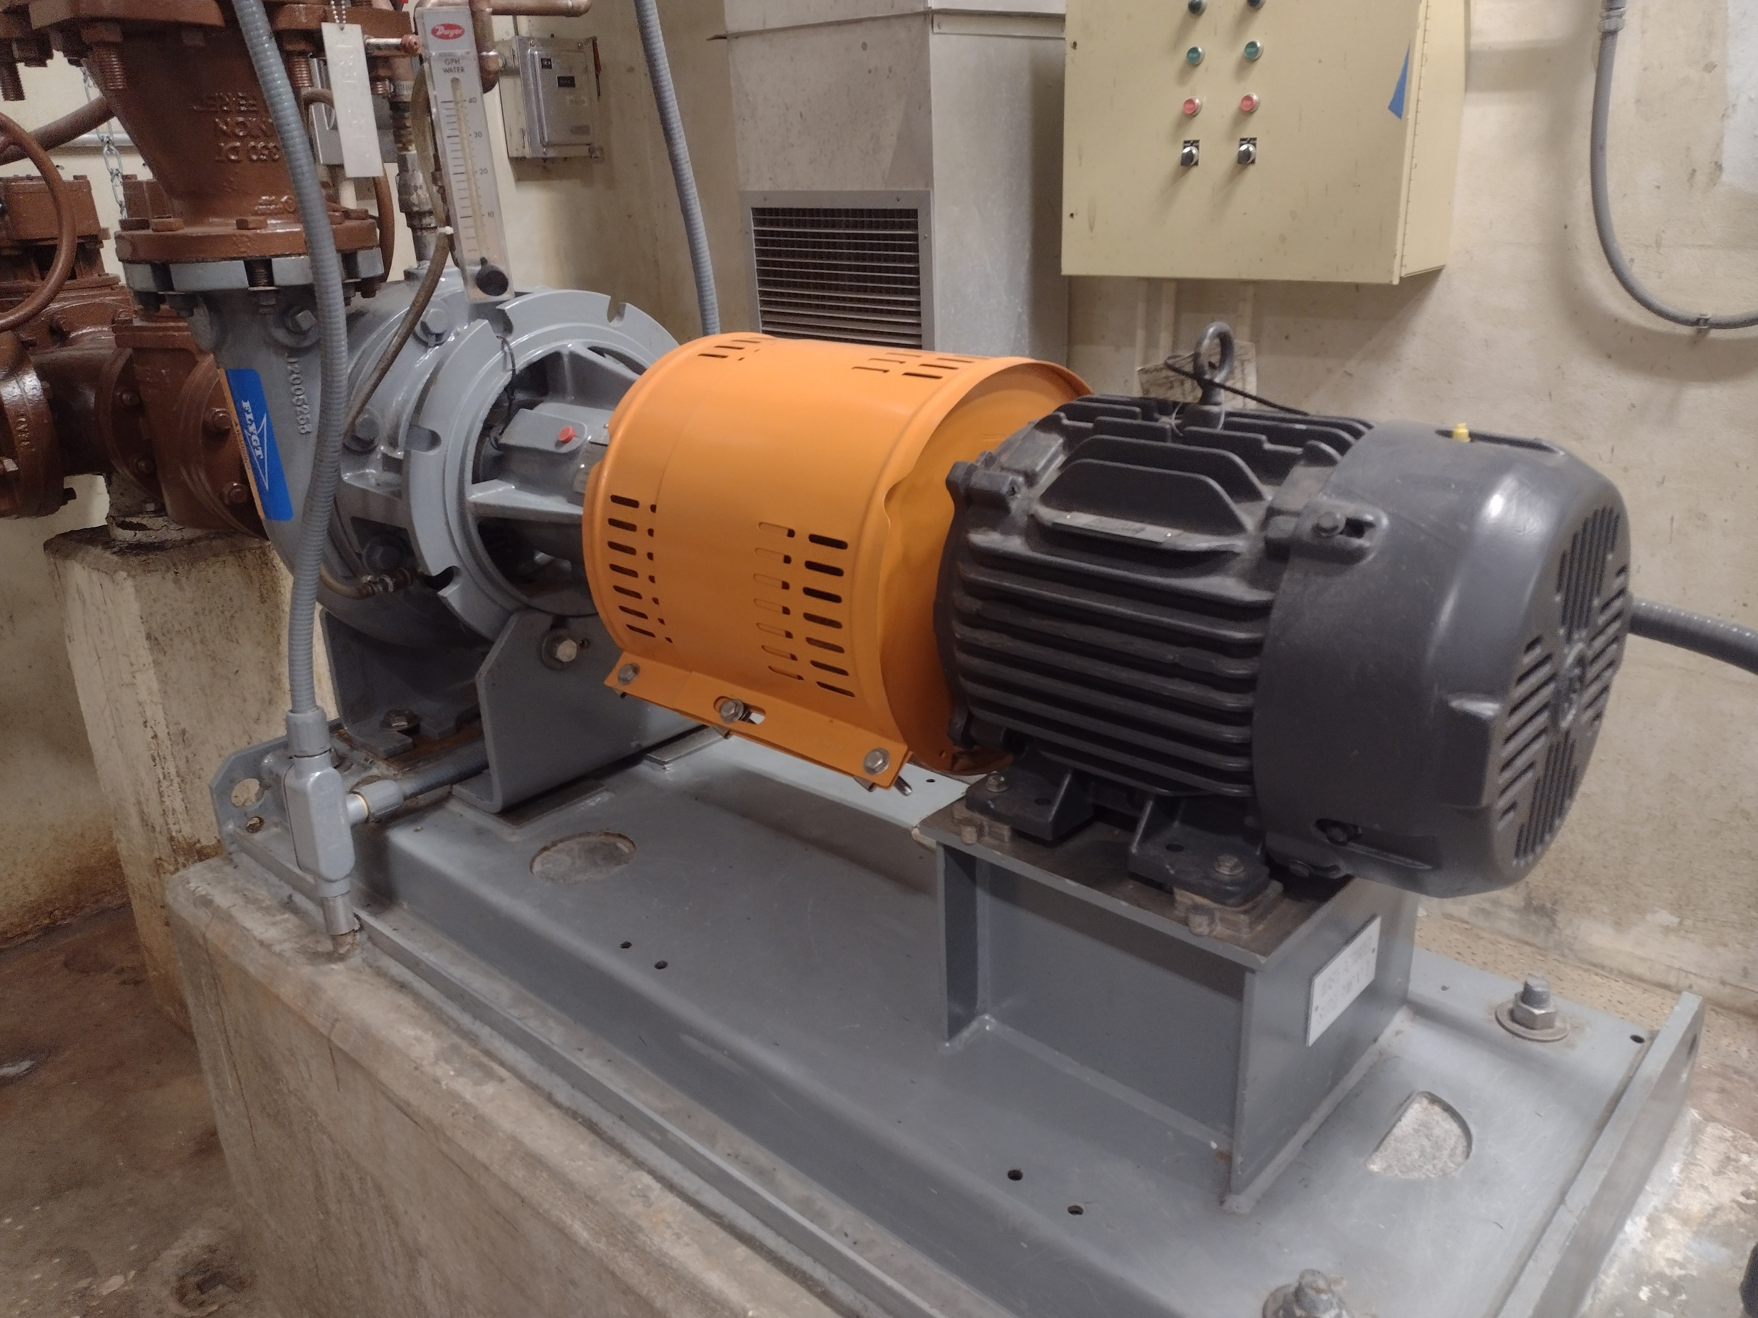
ESCRA LOCKOUT/TAGOUT

Slide 8
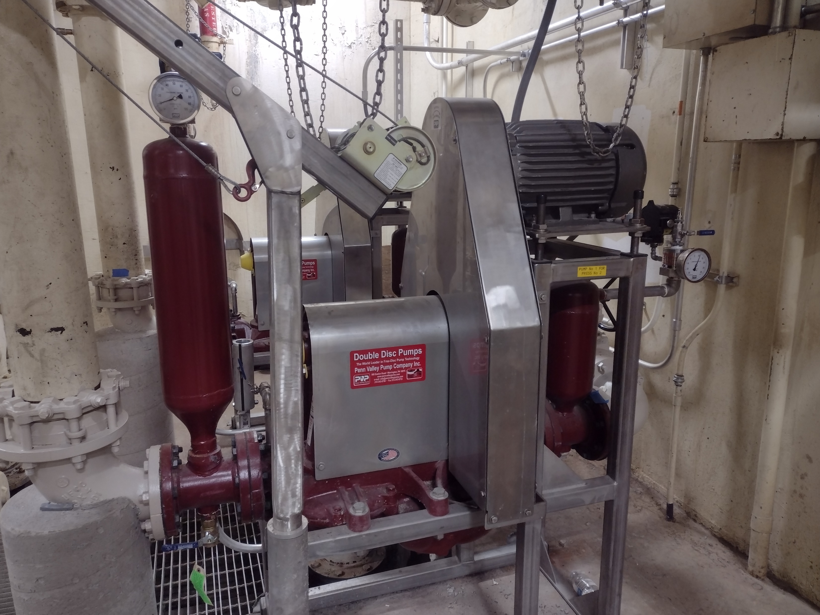
ESCRA LOCKOUT/TAGOUT

Slide 9
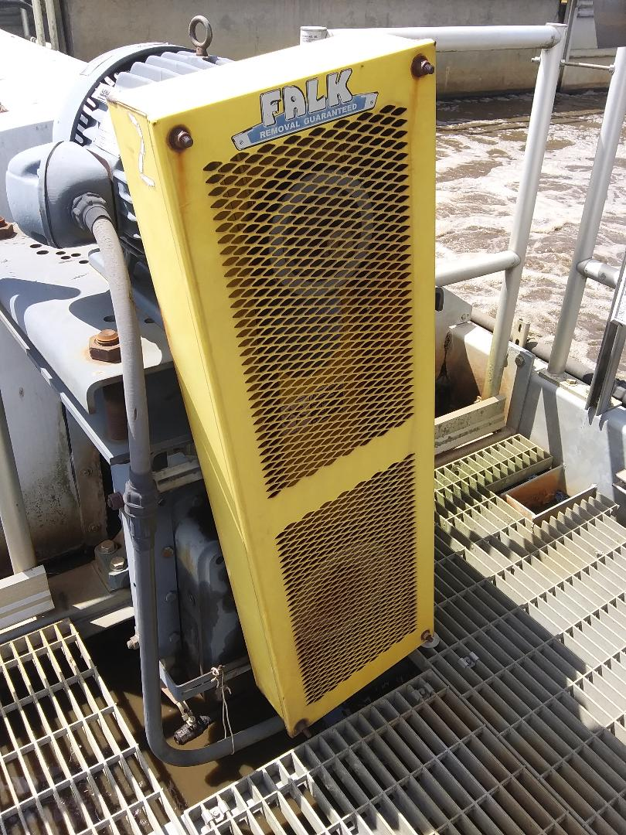
ESCRA LOCKOUT/TAGOUT

Slide 10
ESCRA LOCKOUT/TAGOUT
PLEASE FEEL FREE TO ASK MANAGEMENT ABOUT ANY QUESTIONS OR CONCERNS YOU MAY HAVE ABOUT LOTO.
PLEASE BE CAREFUL AND WORK SAFE

