Slide 1
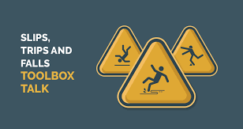
ESCRA Slips, Trips & Falls Training 12/27/2023

Slide 2
ESCRA Slips, Trips & Falls Training
OSHA maintains general industry regulations on walking/working surfaces that guard against hazards including clutter, protruding objects and wet conditions. These hazards can harm everyone in a facility, regardless of title or job responsibilities
Slips, trips, and falls cause nearly 700 fatalities per year and many more injurious accident in the workplace according to the Bureau of Labor Statistics.
There are three physical factors involved in slips, trips, and falls: friction, momentum, and gravity. Each one plays a role. Friction is the resistance between objects, momentum is affected by the speed and mass of an object, and gravity is the force exerted on an object by the Earth.

Slide 3
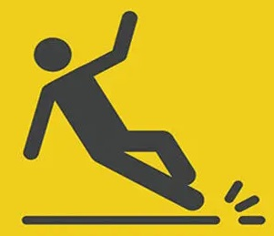
ESCRA Slips, Trips & Falls Training
SLIPS
Slips are a loss of balance cause by too little friction between your feet and the surface you walk or work on. Loss of traction is the leading cause of workplace slips.
Slips can be caused by wet surfaces, spills, or weather hazards like ice or snow. Slips are more likely to occur when you hurry or run, wear the wrong kind of shoes, or don’t pay attention to where you’re walking.

Slide 4
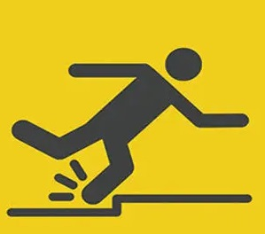
ESCRA Slips, Trips & Falls Training
TRIPS
Trips occur whenever your foot hits an object and you are moving with enough momentum to be thrown off TRIPS balance. Trips are more likely to happen when you are in a hurry and don’t pay attention to where you’re going.

Slide 5
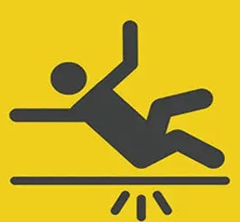
ESCRA Slips, Trips & Falls Training
FALLS
Falls occur whenever you move too far off your center of FALLS balance. Falls account for more workplace fatalities than any other reason.

Slide 6
ESCRA Slips, Trips & Falls Training
Preventing Slips, Trips, and Falls
There are ways that you can help prevent slips, trips, and falls, and keep your worksite safer for you and your coworkers. One simple way is to practice good housekeeping, clean up as you go. Other ways include wearing slip-resistant shoes, being careful when walking on uneven surfaces as well as surfaces that are wet.

Slide 7
ESCRA Slips, Trips & Falls Training
What To Do If Injured
If you are injured on the job site you should report your injury to your supervisor immediately. If you have a serious injury that requires immediate medical attention call 911 or have a coworker call for you. Should you see that a coworker has been injured do your best to notify someone and get immediate medical attention for them. While some slips, trips, and falls may seem minor at first it is always better to get fully checked out. Sprains and strains to your legs, ankles, and back are common with falls on a worksite. Broken bones are also common and need to be treated as soon as possible.

