Slide 1
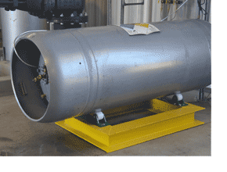
ESCRA Chlorine Safety Training 1/26/2022

Slide 2
What is Chlorine Gas?
Gaseous chlorine is poisonous and classified as a pulmonary irritant. Chlorine gas has the capability of causing acute damage to the upper and lower respiratory tract.
Toxicity to chlorine gas depends on the dose and duration of exposure. At concentrations of 1 to 3 ppm chlorine gas acts as an eye and oral mucous membrane irritant, at 15 ppm there is an onset of pulmonary symptoms, and it can be fatal at 430 ppm within 30 minutes.
Because of its strong odor, chlorine gas can be detected easily. Symptoms of chlorine gas exposure include burning of the nose and throat.

Slide 3
Physical Properties
Chlorine Gas (Cl2)
• 99.5% pure chlorine
Color – greenish yellow
Odor – pungent, similar to laundry bleach. Detectable by smell at concentrations of 0.2 to 0.4 ppm.
Specific gravity – Approximately 2.5. This means gas chlorine is 2.5 times heavier than air, and will sink to the lowest level in a building or area.
Boiling point is -29.15 degrees F. Liquid chlorine that escapes from a cylinder or ton container will immediately convert to gas.

Slide 4
Why is Chlorine used at WWTP
How is Chlorine used in water treatment? Chlorine is a highly efficient disinfectant, and is added to public water supplies to kill disease-causing pathogens, such as bacteria, viruses, and protozoans, that commonly grow in water supply reservoirs, on the walls of watermains and in storage tanks.
Chlorine reacts with water to form hypochlorous and hydrochloric acids, with hypochlorous acid being the main disinfectant.
Disinfection is the process designed to kill or inactivate most microorganisms in wastewater, including essentially all pathogenic organisms. Contrast this to sterilization, which is the removal and destruction of all living microorganisms.

Slide 5
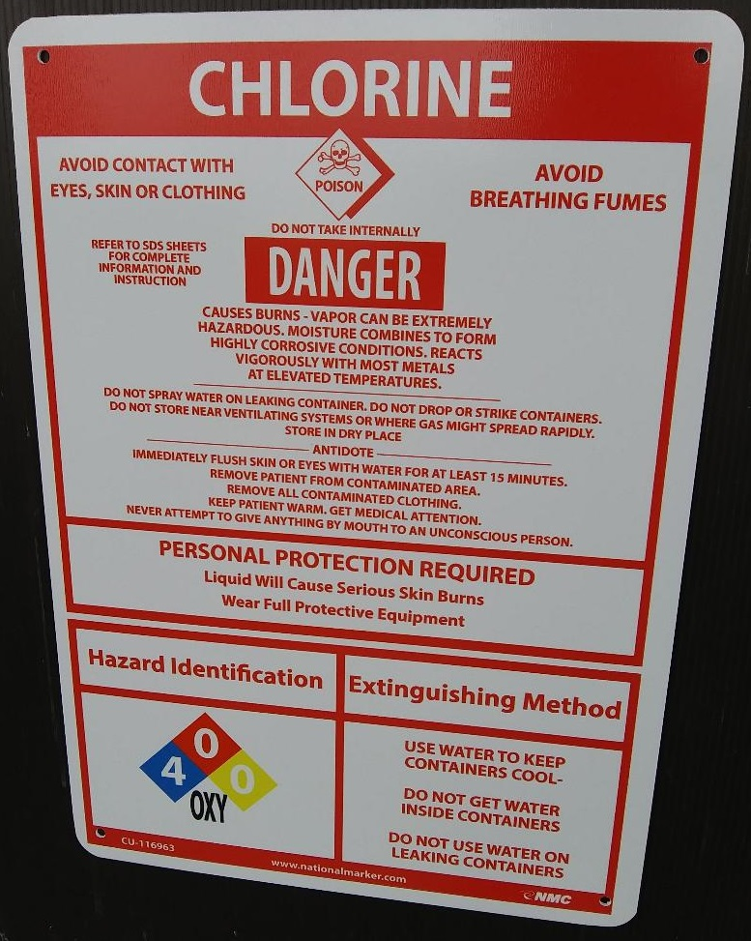

Slide 6
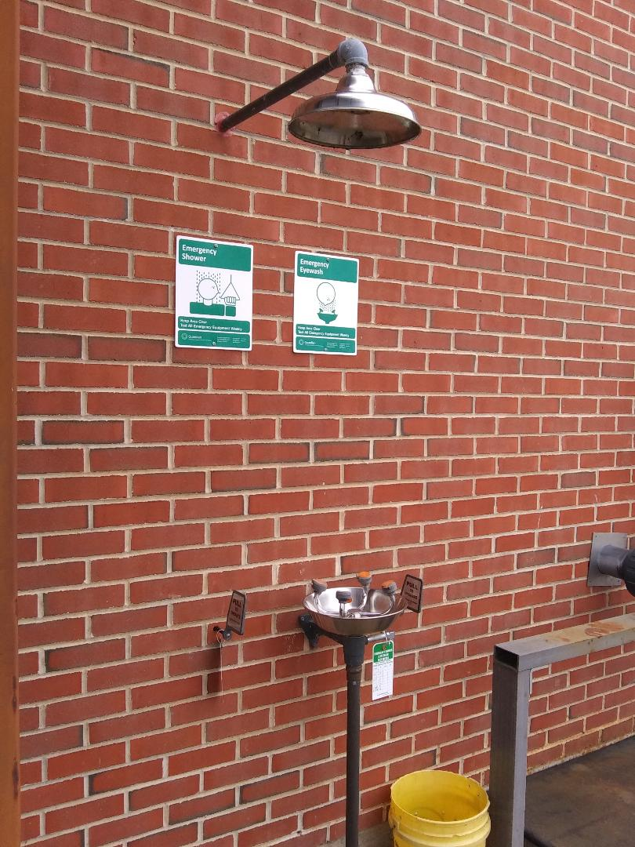
In the event that you come in contact with Chlorine, immediately flush your skin or eyes with water for at least 15 minutes. Remove and contaminated clothing and seek a fresh air environment.

Slide 7
Dangerous Chlorine Reactions
Chlorine is not explosive or flammable, but can react violently with many substances.
Chlorine has the potential for violent or explosive reactions with certain substances. It is very important to separate chlorine from the following:
Ammonia and ammonia compounds
Hydrocarbons – oils, greases, solvents, even in small amounts.
In the event of Fire - Both cylinders and ton containers have fusible metal plugs that will melt when the temperature gets between 158 and 165 degrees F to relieve pressure. These pressure relief valves keep the containers from rupturing during a fire.

Slide 8
How Chlorine Exposure Affects Humans
Chlorine is a severe irritant, when mixed with water (including moisture in mucous membranes, eyes, nose, throat and skin), it forms an acid. The primary route of exposure is through the eyes and respiratory system.
Exposure to chlorine has effects ranging from irritation to death, depending on the concentration and time of exposure.
The OSHA ceiling level (the maximum limit of any worker exposure) is 1.0 ppm.
A level of 10 ppm is considered Immediately Dangerous to Life and Health under the National Institute for Public Safety and Health (NIOSH).
At low levels for a short time, chlorine can cause eye irritation, coughing, sneezing and throat irritation. At higher levels, labored breathing and vomiting may occur. Death can result from suffocation.
Liquid chlorine that vaporizes on skin can reduce the temperature enough to cause frostbite.

Slide 9
Chlorine Leak Detection
Check for chlorine leaks by using a plastic squeeze bottle with a solution of ammonium hydroxide in the bottom. Squeeze to allow only the ammonia vapor (NEVER the liquid) to detect the presence of chlorine. If a leak exists, it will form a white cloud.
In addition, chlorine leak detection instrumentation is recommended, and required in some states. Leak detectors are typically connected to an alarm system with call-out capability for unmanned plants. Leak detectors must be properly maintained, calibrated and tested.

Slide 10
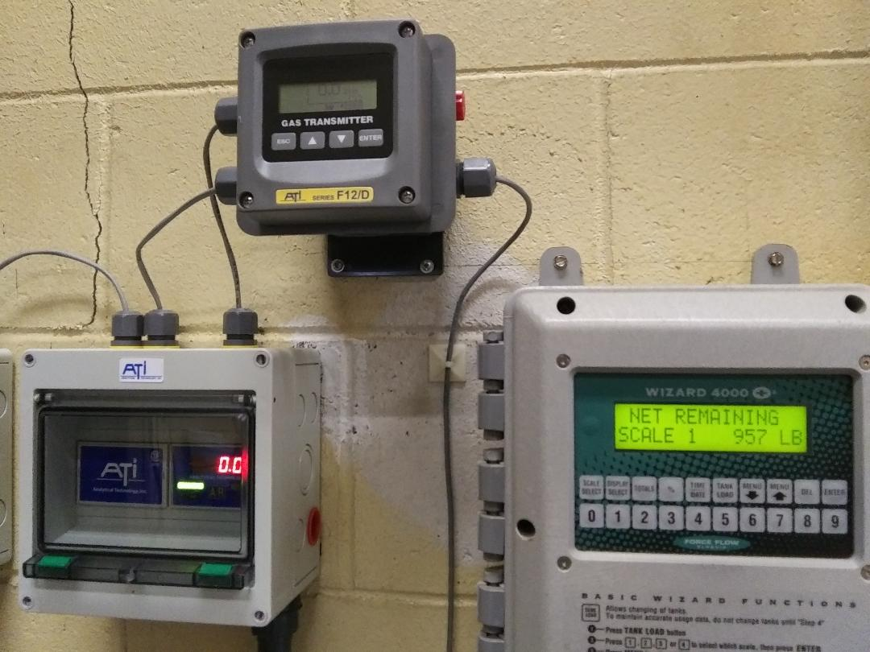
Chlorine Leak Detection

Slide 11
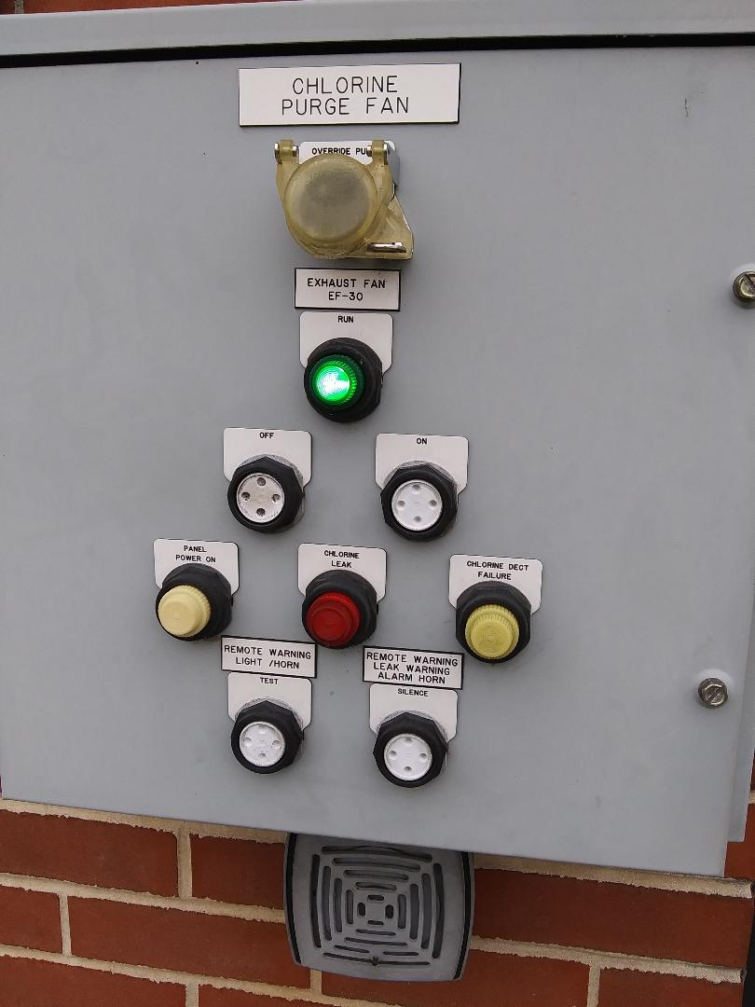
Chlorine Room Outside Panel

Slide 12
Chlorine Leak Response
In the event that an uncontrollable leak occurs all operators should seek a fresh air environment up wind of the leak. The wind sock should be used to determine the wind direction.
NEVER respond to a chlorine leak unless you have been properly trained and have the necessary safety equipment—including a self-contained breathing apparatus and protective suit.
Otherwise, call 9-1-1 or whatever agency is listed in your plant’s Emergency Response Plan.

Slide 13
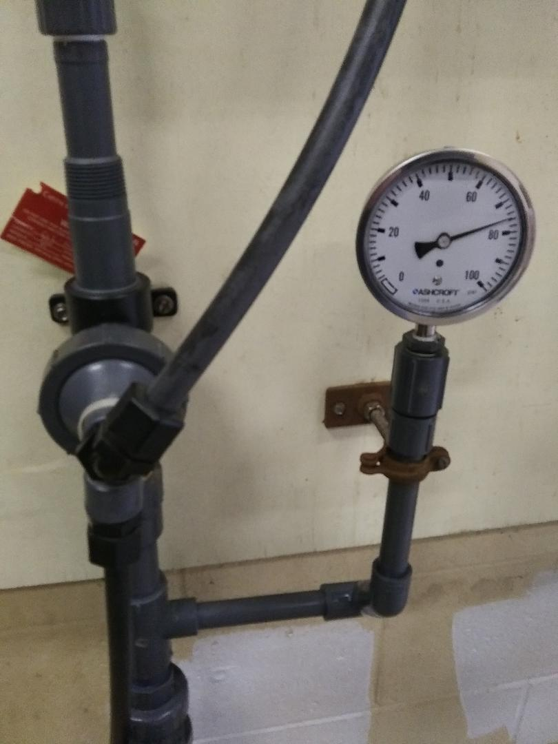
Liquefied Cl2 is released from the tank as chlorine gas, which is then injected into the water stream through the ejector.

Slide 14
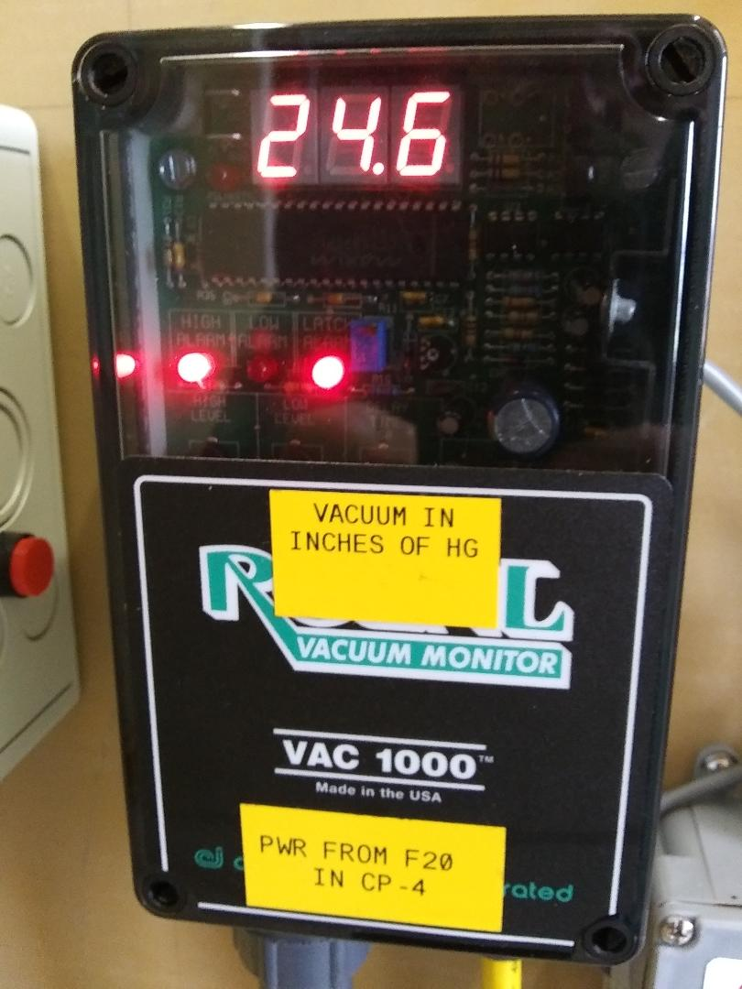
Chlorine Vacuum Gauge

Slide 15
Changing a Chlorine Cylinder
The Chlorine Cylinder Changing SOP should be followed.
Changing cylinders or containers is one of the most likely opportunities for exposure to chlorine. It is extremely important to make sure all operators are thoroughly trained before attempting the task.
Always use proper equipment to unload ton containers.
Make sure the protective valve housing is on securely
The hoist and cables must be in good operating condition. Have a professional inspect the hoist each year and repair or replace it when necessary.
Never stand under a hoisted container. Stand to either side

Slide 16
Changing a Chlorine Cylinder
Ton Containers:
Ton containers should be secured in a horizontal position in a cradle, with the two valves aligned vertically. The top valve will feed gas, the bottom will feed liquid.
Make sure the appropriate personal protective equipment is available and worn during the procedure.
Self contained breathing apparatus with full face mask
Gloves
Hard hat
Safety shoes
Long sleeved shirts
Pants
Clothing and gloves should be free of oil or grease.

Slide 17
Sodium Hypochlorite Upgrade
ESCRA will be updating the Chlorine Room entirely. We will utilize Sodium Hypochlorite for disinfection.
Sodium Hypochlorite is a much safer chemical.
The System will utilize two tanks that will hold 475 gallons each of Sodium Hypochlorite.
The System will utilize two vacuum liquid chemical injectors (no pumps) very similar to our current system.

Slide 18
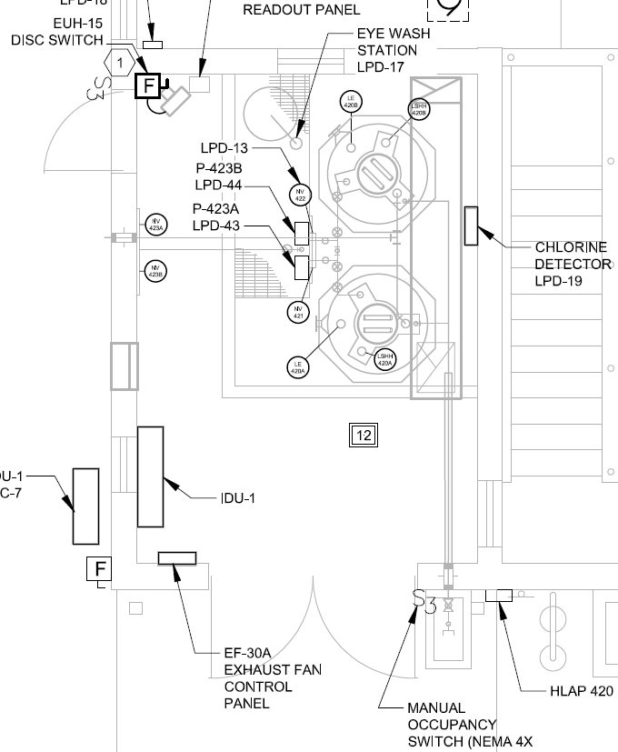
New Sodium Hypochlorite Room Layout

