Slide 1
ESCRA SAFETY TRAINING 5/17/2023
Sodium Hypochlorite (Bleach)
Univar – Liquichlor 12.5% Solution

Slide 2
Sodium Hypochlorite (Bleach) Safety Information
What Is Bleach AKA Sodium Hypochlorite?
Sodium hypochlorite is a green/yellow liquid that smells like chlorine. It is a chemical compound comprised of sodium cation and hypochlorite anion, two compounds with charges that attract one another.

Slide 3
Sodium Hypochlorite (Bleach) Safety Information
The Benefits of Bleach (Sodium Hypochlorite)
Bleach or sodium hypochlorite can be hazardous, when used properly, it can make the world at large a much healthier place. Here is a short list of some of the common residential and industrial uses for sodium hypochlorite:
Bleaching (both in homes and in hospitals, businesses and other public places)
Disinfection
Deodorizing
Stain Removal
Water Treatment (for the public)

Slide 4
Sodium Hypochlorite (Bleach) Safety Information

Slide 5
Sodium Hypochlorite (Bleach) Safety Information
Sodium Hypochlorite (Bleach) is commonly used at ESCRA to treat Foaming outbreaks in the VLR tanks.
Sodium Hypochlorite is surface applied with a sprayer to the affected areas of the VLR and VLR outfall tank.
Sodium Hypochlorite is surface applied to the foam rather then injected into the mixed liquor solution so not to negatively effect the organism in the mixed liquor.

Slide 6
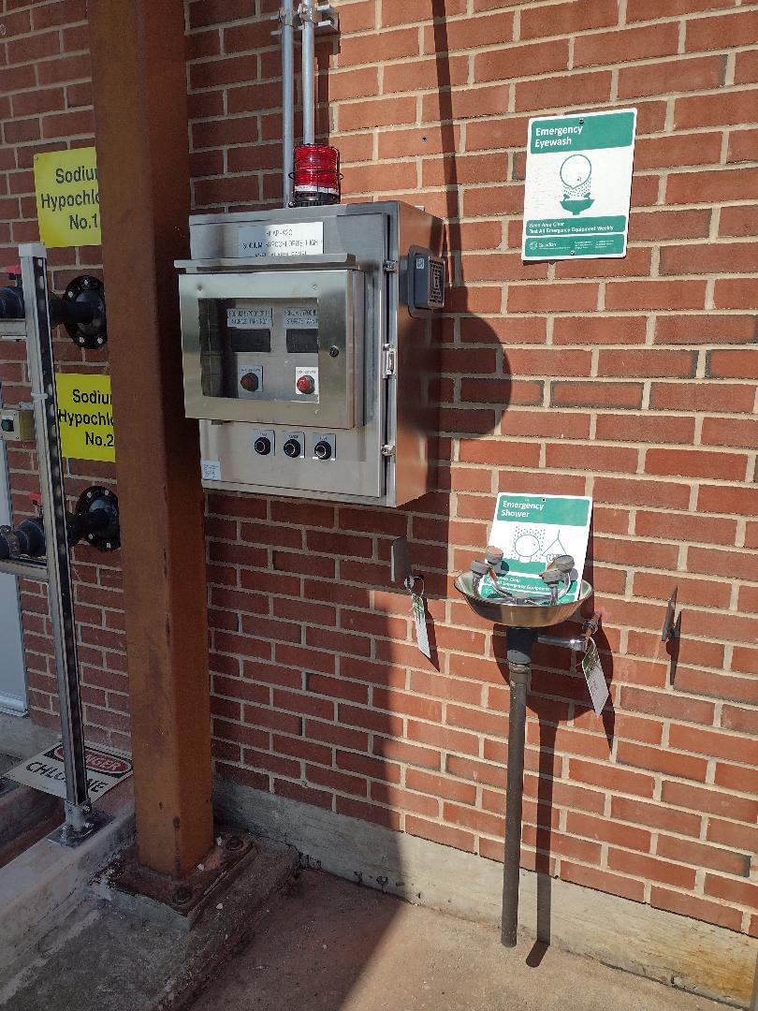
Sodium Hypochlorite (Bleach) Safety Information

Slide 7
Sodium Hypochlorite (Bleach) Safety Information
The dilution of bleach should always be water. The following should NEVER be mixed with bleach:
Acidic toilet bowl cleaners – this can result in deadly, toxic fumes as it creates acidic products mixed with bleach create chlorine gas. This also includes vinegar.
Ammonia – mixing bleach with ammonia will create chloramine vapors, which is a highly toxic and potentially deadly gas. Check the ingredients on other cleaners you may use to ensure none have ammonia in them should you try to mix them with bleach.
Different brands of one kind of products – bleach can be unstable; mixing it with a variety of other chemicals can cause toxic vapors and mixtures

Slide 8
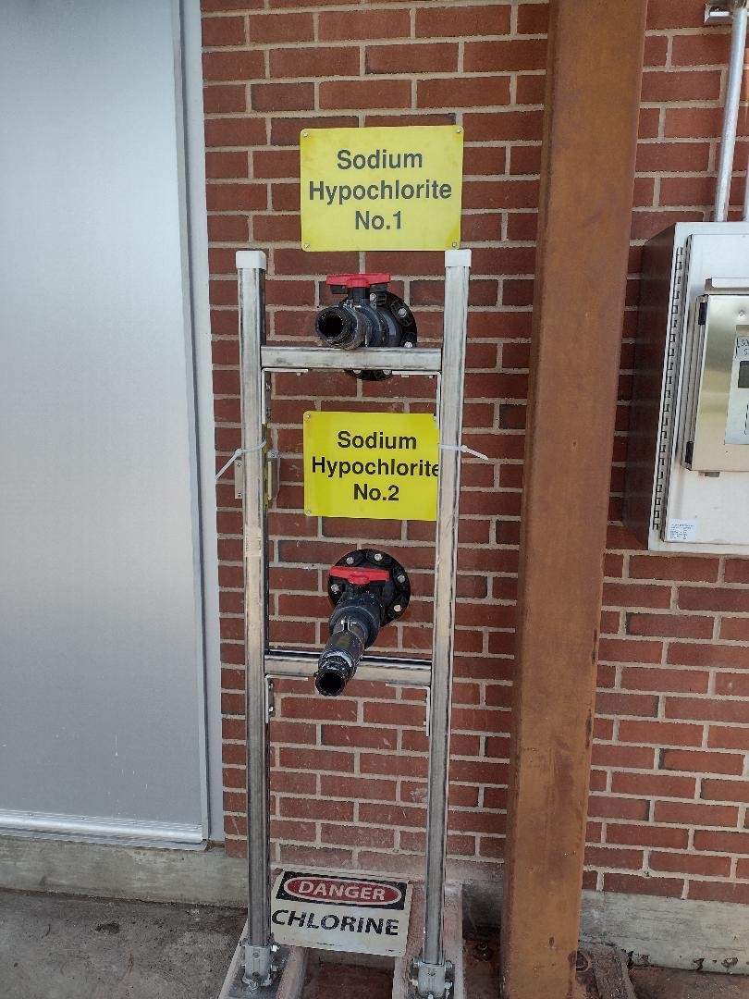
Sodium Hypochlorite (Bleach) Safety Information

Slide 9
Sodium Hypochlorite (Bleach) Safety Information
The NIOSH recommended exposure limit is 0.5 part per million (ppm), which should not be exceeded during any 15 minute work period. The American Industrial Hygiene Association recommends a Workplace Environmental Exposure Level of 2 mg/m (milligrams of a chemical in a cubic meter of air) for a 15 minute work period.
For those businesses and industries with employees using bleach, proper workplace controls and practices need to be implemented and personal protective equipment (PPE) need to be provided, including eyewear, clothing and gloves.

Slide 10
Sodium Hypochlorite (Bleach) Safety Information
Sodium Hypochlorite can be:
May be corrosive to metals.
Causes severe skin burns and eye damage.
Causes serious eye damage.
May be harmful if swallowed.
Very toxic to aquatic life with long lasting effects.
Very toxic to aquatic life.
Wash thoroughly after handling. Do not eat, drink or smoke when using this product. Do not breathe dust or mists. Wear protective gloves/ protective clothing/eye protection/face protection.

Slide 11
Sodium Hypochlorite (Bleach) Safety Information
IF INHALED: Remove person to fresh air and keep comfortable for breathing.
IF IN EYES: Rinse cautiously with water for several minutes. Remove contact lenses, if present and easy to do. Continue rinsing. IF ON
SKIN (or hair): Take off immediately all contaminated clothing. Rinse skin with water/shower for at least 15 minutes.
Seek medical attention immediately.
Wash contaminated clothing before reuse.

Slide 12
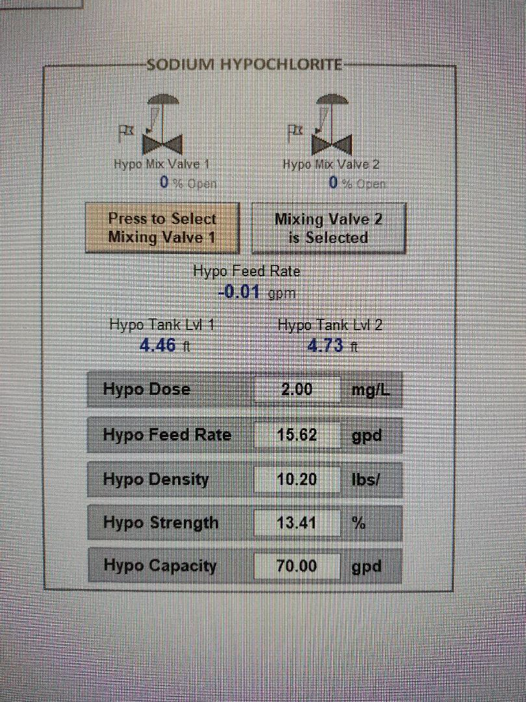
Sodium Hypochlorite (Bleach) Safety Information

